Slide 1
Cisco Smart Career
Team WaitListers:
Abinaya Mahendran
Alka Luqman
Bhavanam Ravindra Reddy
Sahitya Sindhu
Sreeraag Gorty
Vijay Kumar G C

Slide 2
What and Why?
A team with a particular requirement can filter the apt people for the job
Facilitate cross disciplinary movement, thereby improving employee satisfaction and reducing training costs
Skillset Recommender
People recommender system based on skills*
Notes:
By building an intelligent skill based talent recommendation system which maps an employee’s expertise to a business requirement
By recommending a profile which matches your skill set
By recommending the additional skills an employee must gain, given a job profile, so that he/she can actively work towards their goal.

Slide 3
How?
Scrape CEC data, recording expertise
In training set allocate job profiles as class labels
Model a multi class classification problem using SVM
Apply prediction from the SVM model to recommend a job profile for a given skill set
Use information gain to rank skills for a particular job profile
List top 5 skill sets for a given job profile

Slide 4
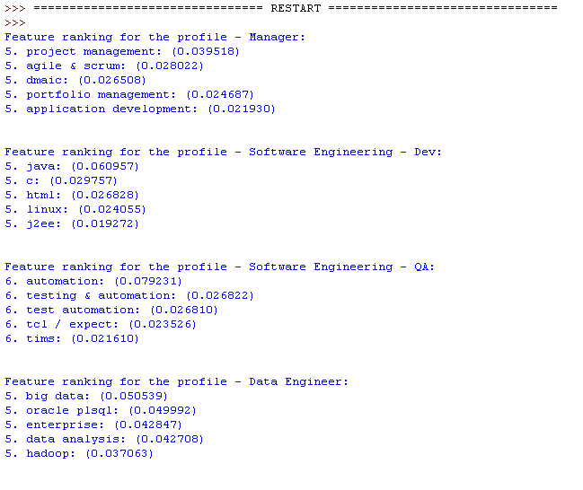
Demo

Slide 5
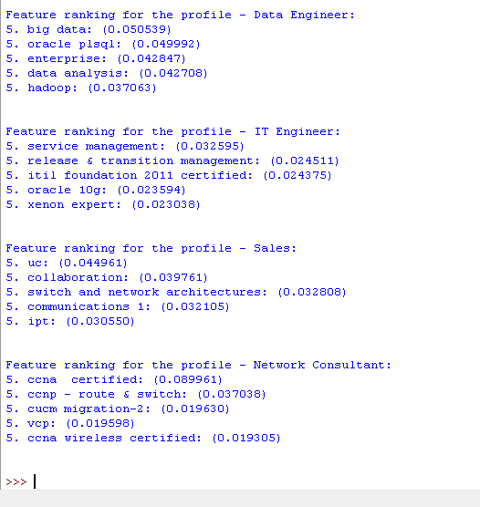

Slide 6
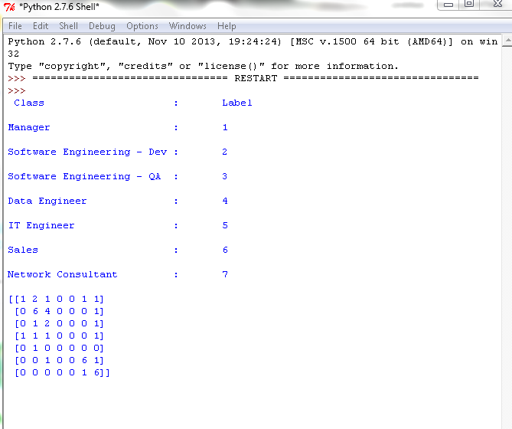
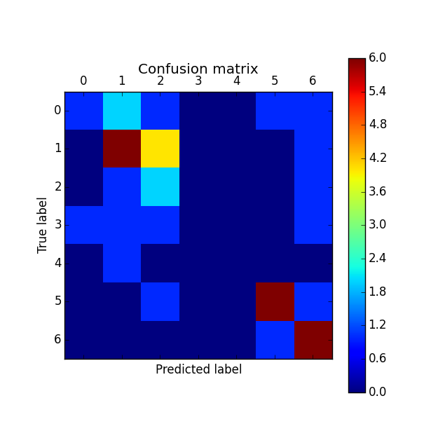

Slide 7
